Slide 1
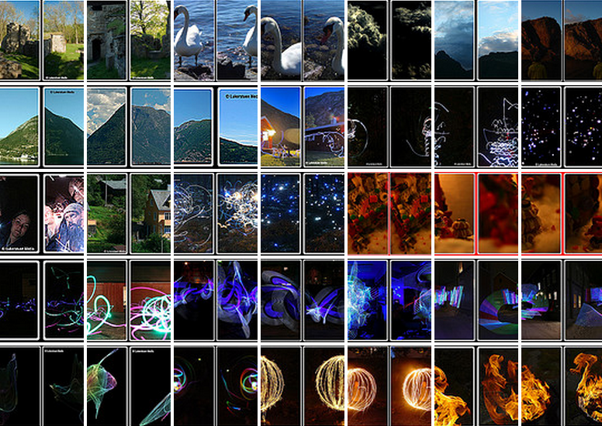
Stereo: Formal Solutions Class 4-5

Slide 2
Today
Geometry and Algebra
Using projective geometry
Computing epipolar geometry
Computing Triangulation
Correspondence
Other stereo images
Homography

Slide 3
Geometry and Algebra
Point ≡ vector
Line ≡ vector

Slide 4
Homogenous Representation: lines
A line is a set of points:
A line vector :
A line, u, is a set of points:
Equivalent line vectors:
The projective space:

Slide 5
Homogenous Representation: points
Inhomogeneous coordinates of a point:
Homogeneous coordinates of a point :
where
Equivalent points:

Slide 6
Degrees of Freedom
For a point:
Inhomogeneous: x and y
Homogeneous: a:c, b:c
For a line:
Inhomogeneous: a:b:c
Homogeneous: a:c, b:c

Slide 7
Intersection of lines
Consider two lines:
u=(a,b,c)^{T} and v=(a’,b’,c’)^{T}
The intersection of u and v :
p=uxv
pv=0 and pu=0
The point p lies on both lines u and v.

Slide 8
Intersection of parallel lines
Consider two parallel lines:
u=(a,b,c)^{T} and v=(a,b,c’)^{T}
The intersection of u and v:
p=uxv=(c’-c)(b,-a,0)^{T}=(b,-a,0)^{T}
Inhomogeneous coordinates:
(b/0,-a/0)^{T}

Slide 9
A line through two points
Consider two points:
p=(x,y,z)^{T} and q=(x’,y’,z’)^{T}
The line connecting the two points:
u=pxq
pu=0 and qu=0
The points p and q both lie on the line u

Slide 10
Addition
Non-homogenoues coordinates: (a,b)+(x,y)=(a+x,b+y)
Homogenoues coordinates P² : (a,b,c)+(x,y,z)=(za+cx,zb+cy,cz)
Homogenoues coordinates P³ : (a,b,c,d)+(x,y,z,w)=
(wa+dx,wb+dy,wc+dz,dw)

Slide 11
Scalar Multiplication
Inhomogenoues coordinates:
x(a,b) =(xa,xb)
Homogenoues coordinates P²:
x(a,b,c) =(xa,xb,c)

Slide 12
The Projective Space
Two dimensional:
Three dimensional:

Slide 13
Back to Stereo

Slide 14
Stereo Main Issues
Correspondence
Geometric constraints
Local information
Global information
Reconstruction (triangulation)
Calibration

Slide 15

Correspondence: Geometry
+
+

Slide 16
Epipolar Lines
Left Image
Object point
Cop
Cop

Slide 17
Epipolar Geometry
A pair of corresponding points must lay on corresponding epipolar lines
Epipolar Plane
Left Image
Right Image
Epipolar line
Epipolar line
COP
Baseline
COP

Slide 18
The epipole points are e_{l} and e_{r}
Object Point
Left Image
Right Image
α
β
COP
e_{l}
e_{r}
COP
Notes:
When the two image planes and the center of projections are known, it is possible to compute the 3D location of a point from the two images.

Slide 19
Epipole
The Epipole is the projection of the cop of the other camera
Except for the epipole, only one epipolar line goes through any image point
All the epipolar lines go through the epipole

Slide 20
Epipole
What happens when the two camera planes are parallel?

Slide 21
Example: Converging Cameras

Slide 22
Example: Pure translation

Slide 23
The Fundamental Matrix, F
F is a 3×3 matrix of rank 2
Let p_{L} and p_{R} be corresponding image points:
Each point in one image defines the epipolar line in the other image: and
F is based on intrinsic and extrinsic parameters

Slide 24
Algebraic Formulation Pinhole Camera

Slide 25
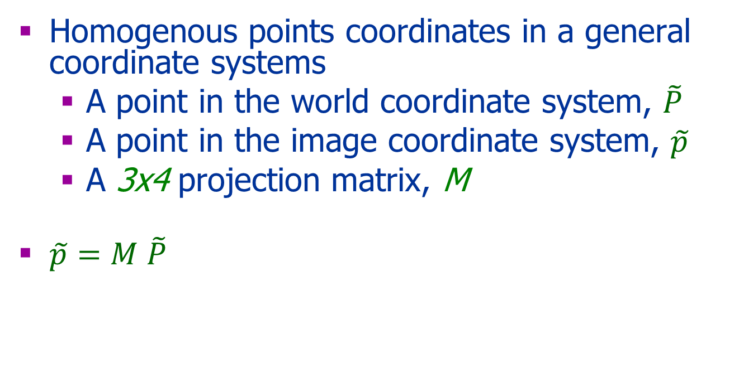
Pinhole Camera: Algebra
Homogenous points coordinates in a general coordinate systems
A point in the world coordinate system, $\tilde{P}$
A point in the image coordinate system, $\tilde{p}$
A 3x4 projection matrix, M
$\tilde{p}=M \tilde{P}$
y
y
x
x
y
x
z

Slide 26

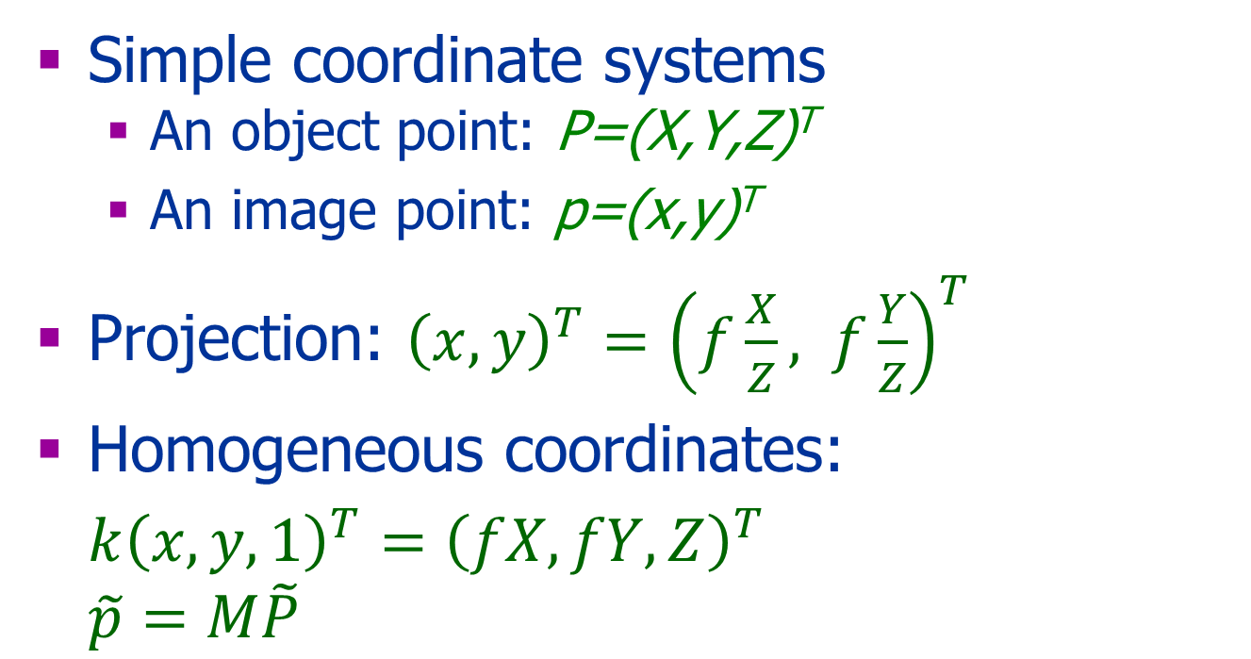
Intrinsic Parameters
y
Simple coordinate systems
An object point: P=(X,Y,Z)^{T}
An image point: p=(x,y)^{T}
Projection: ${\left(x,y\right)}^{T}={\left(f\frac{X}{Z}, f\frac{Y}{Z}\right)}^{T}$
Homogeneous coordinates:
$k{\left(x,y,1\right)}^{T}={\left(fX,fY,Z\right)}^{T}$ $$\tilde{p}=M\tilde{P}$$
x
y
x
z
$$M$$

Slide 27
Change of Image Coordinates
y
image point
x
Object point
z
Cop
(0,0,0)
y
principal axis
x
principal point
(0,0,f)
(x₀,y₀)

Slide 28
Intrinsic Parameters
O=(o_{x} o_{y})^{T} is the principal point
f : focal length
y
Y_{object}
y_{image}
z_{object}
f
O
o_{y}
x
(0,0)
o_{x,}
Computer Vision by Y. Moses

Slide 29
Principal Point Offset
Assume principal point at (o_{x},o_{y})^{T.}
P=(X,Y,Z)^{T} and p=(x,y)^{T} are related by:
Homogeneous coordinates:

Slide 30
Pixel Scaling
P=(X,Y,Z)^{T} and p=(x,y)^{T} are related by:
Homogeneous coordinates:

Slide 31
Internal Parameters
Let p be the projection of the object point P then :
where
or

Slide 32
Questions
Assume f=s_{x}=s_{y}=1 and o=(0,0)
What are the projections of:
P1=(0,0,10)^{T} → p1=?
P2=(1,0,5)^{T} → p2=?
P3=(1,0,0.5)^{T}→ p3=?

Slide 33
An Image Pair
Two coordinate systems: left and right.
C_{l}=(0,0,0)^{T} in the left system.
C_{r}=(0,0,0)^{T} in the right system.
Object Point
Left Image
Right Image
O
f
α
O
β
Cop
Cop
Notes:
When the two image planes and the center of projecions are known, it is possible to compute the 3D location of a point from the two images.

Slide 34
Notation
Let P=(X_{l},Y_{l},Z_{l})^{T} and P=(X_{r},Y_{r},Z_{r})^{T}
P P
The projection of P onto the left image:
Object point
p_{l}
The projection of P onto the right image:
+
α
β
C_{L}
+
C_{R}
Note: P≠ p_{l} and P≠ p_{r}
Notes:
When the two image planes and the center of projections are known, it is possible to compute the 3D location of a point from the two images.

Slide 35
Change of Camera Coordinates
y
y
x
x
y
Object point
x
z
(0,0,0)
Cop
(0,0,0)
principal axis
(x_{c},y_{c},z_{c})
z
principal point
(0,0,f)
(x₀,y₀,z_{o})

Slide 36
3D Rigid Transformation
Given a point in two coordinate systems:
Left coordinate system: P_{l}=(P_{l},Y_{l},Z_{l})^{T}
Right coordinate system: P_{r}=(X_{r},Y_{r}, Z_{r})^{T}
The rigid transformation between the two cameras’ coordinate systems: R, T
Then: P_{r}= R(P-T)

Slide 37
Only Translation In 2D:
T= P_{r0}⁻ P_{l0}
P_{r}= P_{l}+ T
y
y
P_{l}=[x_{l} y_{l}]^{T}
P_{r}=[x_{r} y_{r}]^{T}
x
x
x
P_{l0}=[x₀ y₀]^{T}
P_{r0}=[0 0]^{T}

Slide 38
Translation in 3D
Let T=(T_{x},T_{y},T_{z})^{T}
Nonhomegeneous: P_{r}=P_{l}-T
Homogeneous:

Slide 39
Only Rotation in 2D: P_{r}=RP_{l}
P_{r}=(x_{r} y_{r})^{T}
y
P_{l}=(x_{l} y_{l})^{T}
y
x
P_{r0}=(0 0)^{T}
α
x
P_{l0}=(0 0) ^{T}

Slide 40
Rotation in 3D
Let R be a rotation matrix (RR^{T}=I).
Inhomegeneous: P_{r}=RP_{l}
Homogeneous:

Slide 41
Translation and Rotation P_{r}=R(P_{l}-T)
y
P_{l}=[x_{l} y_{l}]^{T}
y
P_{r}=[x_{r} y_{r}]^{T}
x
P_{r0}=[0 0]^{T}
x
P_{l0}=[x₀ y₀]^{T}

Slide 42
3D Rigid Transformation
Let R be a rotation matrix, T be a translation vector
Inhomegeneous: P_{camera}=R(P_{world}-T)
Homogeneous: where

Slide 43
From Camera to Image Coordinate System
When camera and object are within the same coordinate system: where
Where the camera has a different coordinate system: where:

Slide 44
The COP
The camera center, , is the null vector of M :
Let be any point in 3D
The projection of a point to the image: ,
The degree of M is 3
Choose such that
A line through and :
For each choice of , all points P(λ) are mapped to the same image point : is COP

Slide 45
Tiangulation

Slide 46
A Simple Stereo System
Object point
The two camera planes are coplanar
The two optical axes are parallel
The two focal lengths are identical
The fixation point lies at infinity
The correspondence is given
f
f
Left Image
Right Image
α
β
+
+
Cop
Cop
Notes:
When the two image planes and the center of projecions are known, it is possible to compute the 3D location of a point from the two images.

Slide 47
Computing the Depth from Disparity
P
The disparity:
d =x_{l}-x_{r}
Z
Z-f
O_{L}
O_{r}
x_{l}
x_{r}
f_{l}
p_{l}
p_{r}
f_{r}=f_{l}
T
cop_{l}
cop_{r}

Slide 48
General Case Triangulation
Object Point
Left Image
Right Image
O
+
α
O
β
+
Cop
Cop
Possible to use trigonometry but projective geometry is nicer & easier
Notes:
When the two image planes and the center of projecions are known, it is possible to compute the 3D location of a point from the two images.

Slide 49
Triangulation
We are looking for P such that:
and
P is the intersection of the two lines
P(λ) and Q(λ’)
How to compute?
Q(λ)
P(λ)
Object Point
P
O
p
q
f
How to compute?
O
Cop
Cop

Slide 50
Back Projection Ray
Let M be the projection matrix
Let p be an image point
Let P be a point in 3D that project to p
The ray P(λ) is given by:
P(λ)=λC+(1- λ)P
p
P(λ)
P
C
Note: p and P are nonhomogeneous coordinates.

Slide 51
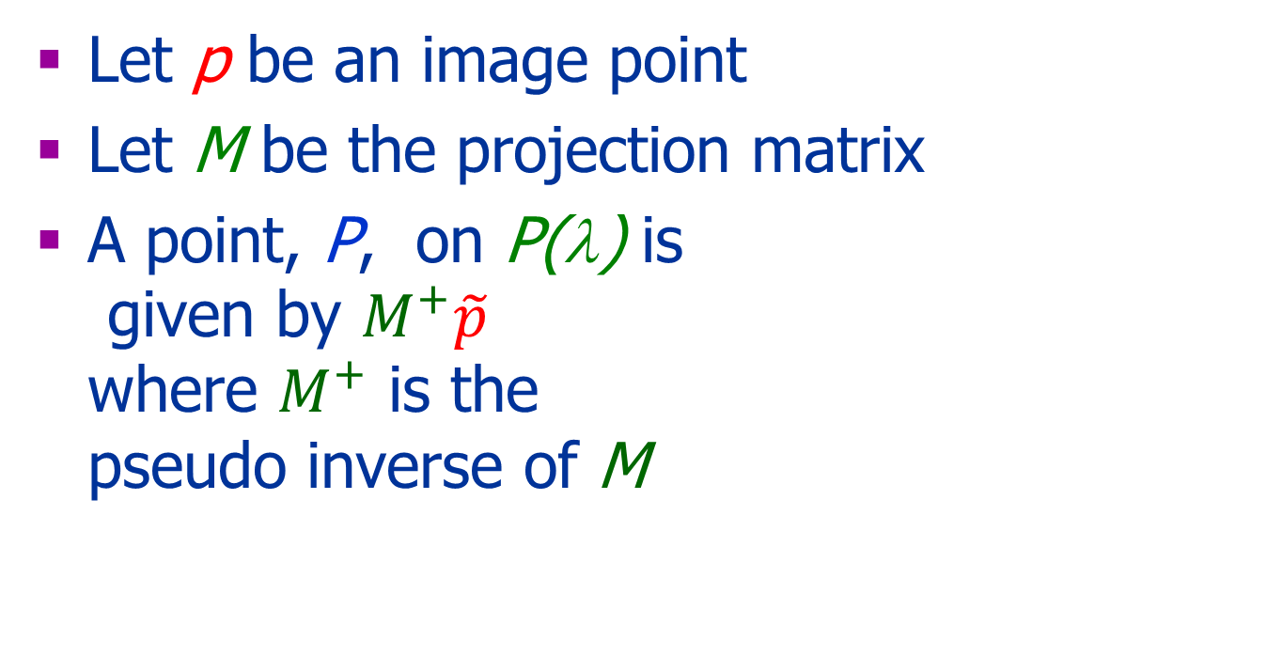

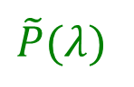
Back Projection Ray
Let p be an image point
Let M be the projection matrix
A point, P, on P(λ) is given by $M^{+}\tilde{p}$ where $M^{+}$ is the pseudo inverse of M
$\tilde{p}$
$\tilde{P}(λ)$
P

Slide 52
Pseudoinverse
Let A be a n×m matrix where n<m
Define A⁺=A^{T}(A A^{T})⁻¹
AA⁺= I
In our case, given an image point , and a projection matrix M, the 3D point
projects to the image point :
Note: and are homogeneous coordinates

Slide 53
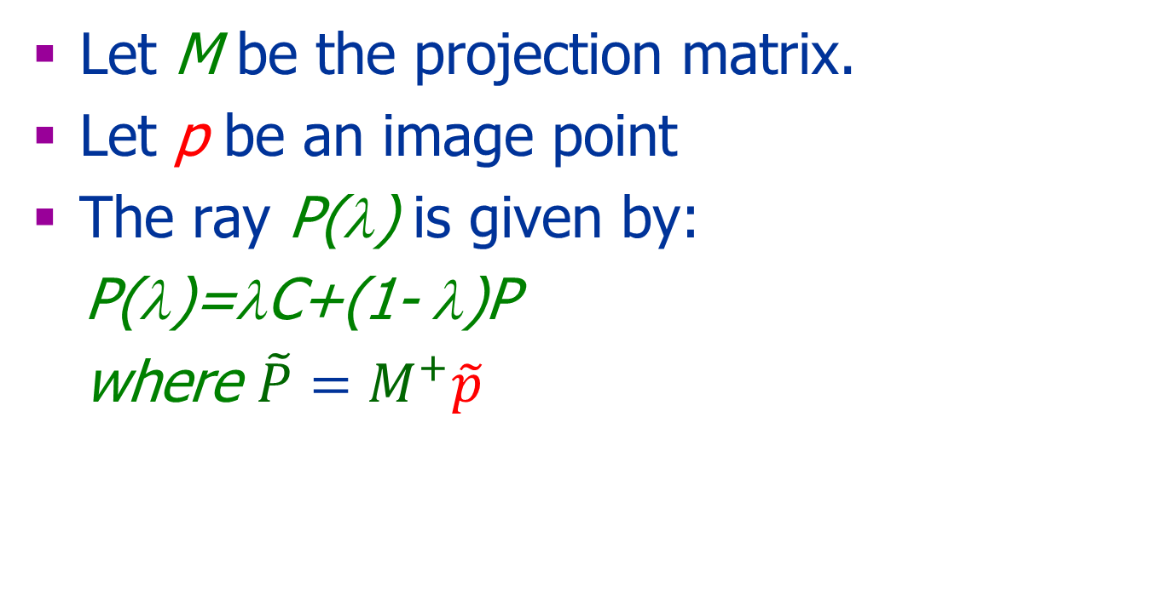
Back Projection Ray
Let M be the projection matrix.
Let p be an image point
The ray P(λ) is given by:
P(λ)=λC+(1- λ)P
where ${\tilde{P}=M}^{+}\tilde{p}$
p
P(λ)
C

Slide 54
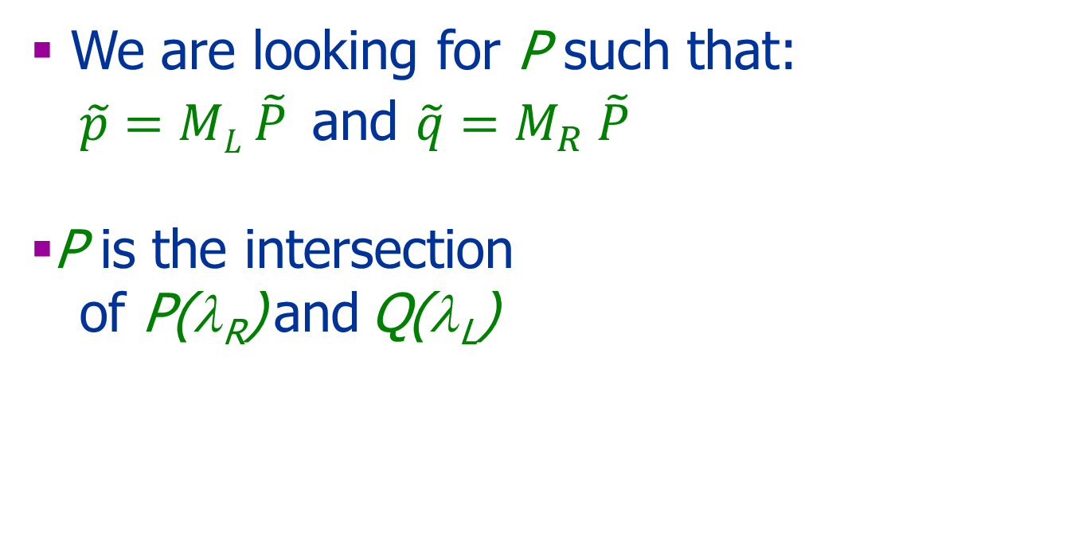
Triangulation
We are looking for P such that: $\tilde{p}=ML \tilde{P}$and $\tilde{q}=M_{R} \tilde{P}$
P is the intersection
of P(λ_{R}) and Q(λ_{L})
Q(λ_{R})
P(λ_{Ll})
Object Point
P
O
p
q
f
O
Cop
Cop

Slide 55
Triangulation
When P(λ) and Q(λ’) do not intersect,
we are looking for P that minimizes:
d(P,P(λ))²⁺ d(P,Q(λ’))²
Other possibilities…
Object Point
P
O
p
q
f
O
Cop
Cop

Slide 56
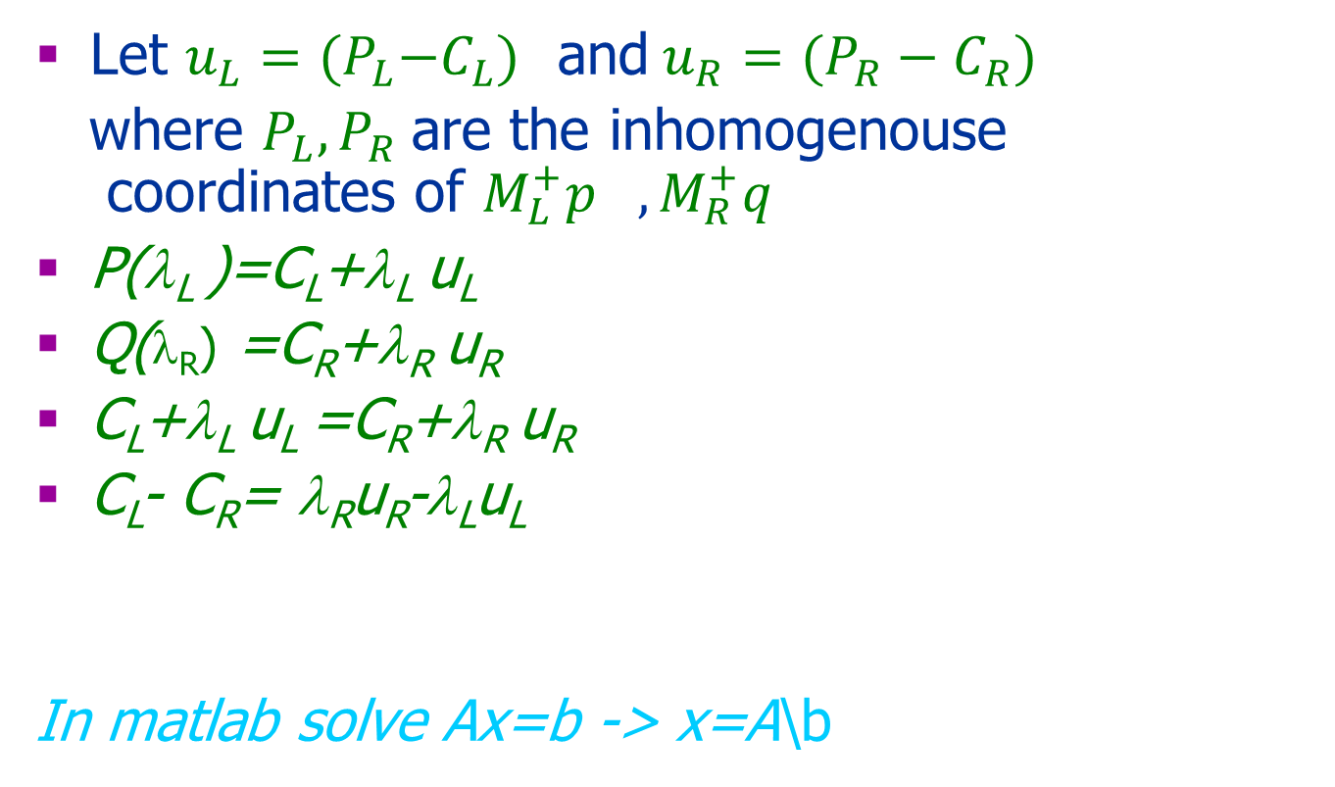
Triangulation: min(d(P,P(λ_{L}))²⁺ d(P,Q(λ_{R}))² )
Let $u_{L}={(P}_{L}−C_{L})$ and$u_{R}=(P_{R}−C_{R})$
where $P_{L}, P_{R}$are the inhomogenouse coordinates of $M_{L}^{+}p_{},M_{R}^{+}q$
P(λ_{L} )=C_{L}+λ_{L} u_{L}
Q(λ_{R}) =C_{R}+λ_{R} u_{R}
C_{L}+λ_{L} u_{L} =C_{R}+λ_{R} u_{R}
C_{L}- C_{R}= λ_{R}u_{R}-λ_{L}u_{L}
In matlab solve Ax=b -> x=A\b
P
P_{R}
Object Point
P_{L}
O
p
q
f
O
C_{R}
C_{L}
C_{R}
Notes:
the 3D location of a point from the two images.

Slide 57
Triangulation: Another Minimization
Minimize the distance of the projected point to the two image.
Choose P that minimizes:

Slide 58
The Fundamental Matrix

Slide 59
Epipolar Lines
Objet point
+
+
Center of
projection
Center of
projection

Slide 60
Determining the Epipolar Lines
Depends on the intrinsic and extrinsic parameters
Algebraic description homogenous coordinates:
A line is given by v
A point p lay on a line v if vp=0

Slide 61
The Fundamental Matrix, F
F is a 3×3 matrix of rank 2
Let p_{L} and p_{R} be corresponding image points:
Each point in one image defines a line in the other image: and
F is based on intrinsic and extrinsic parameters

Slide 62
Computing F
Let M_{L} and M_{R} be the projection matrices
A point in 3D that projects to p_{l}
Its projection to the right image
The line in the right image
u
P
p_{l}
p_{r}
Cop_{r}
Cop_{l}
e_{l}
e_{r}
β
Left Image
Right Image
Notes:
When the two image planes and the center of projections are known, it is possible to compute the 3D location of a point from the two images.

Slide 63
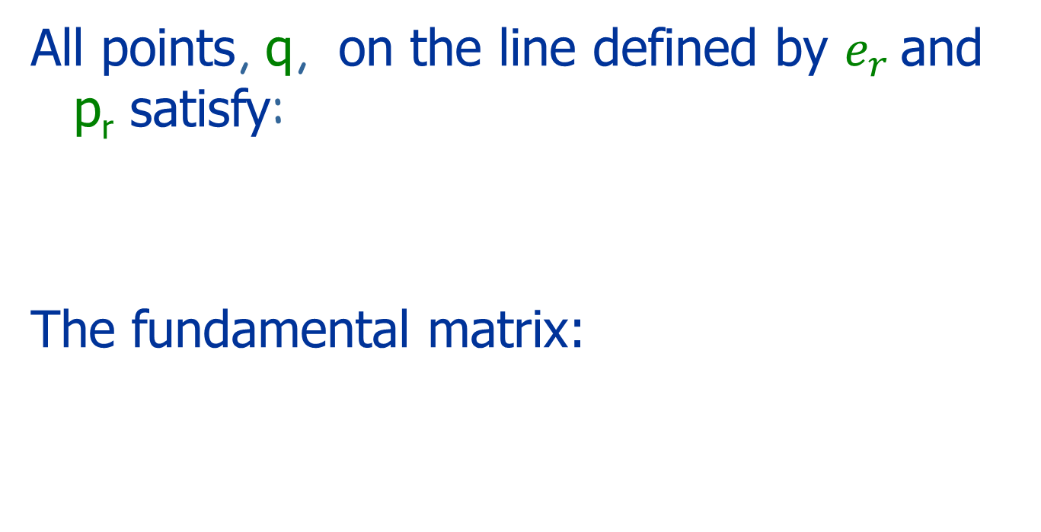
Computing F
All points, q, on the line defined by $e_{r}$ and p_{r} satisfy:
The fundamental matrix:
u
P
p_{l}
p_{r}
Cop_{l}
e_{l}
e_{r}
β
Cop_{r}
Left Image
Right Image

Slide 64
Vector Product
*
v
*
u
uxv
*
where

Slide 65
Summary Fundamental Matrix
If p_{L} and p_{R} are corresponding image points then
Epipolar lines: and
The epipoles: and

Slide 66
A Special Case: Pure Translation
Assume:
The world coordinate system is the left camera’s system
Both cameras have the same intrinsic projection matrix
The right camera is only translated in the x direction
Then:

Slide 67
A Question
What is kF?

Slide 68
Computing F
Given the internal and external parameters of the cameras:
When the cameras’ parameters are unknown: use 8 (or more) corresponding points

Slide 69
Computing F
Assume n≥8 corresponding points are given
Use these points to solve the 8 unknowns of F based on:
Avoid degenerate configurations

Slide 70
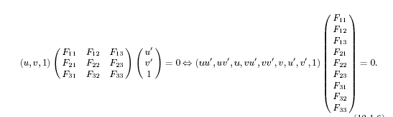
Eight Points Algorithm
Each pair of corresponding points defines one linear equation in 8 unknowns

Slide 71
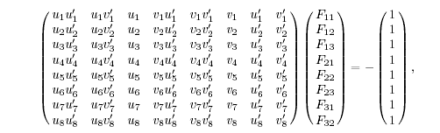
8 pairs of corresponding points define eight linear equations in 8 unknowns
Solve the linear equations and find F

Slide 72
Improve the 8 points algorithm
F has rank 2
Enforce the rank 2
E.g. Hartley 1995

Slide 73
Rectification
Simplify the use of epipolar lines
u
P
p_{l}
p_{r}
C_{l}
C_{r}

Slide 74
Rectification
Let A and B be 3×3 non singular matrices.
Transform the left image by p’_{L}=Ap_{L}
Transform the right image by p’_{R}=Bp_{R}
Choose A and B such that F’=A^{-T}FB⁻¹ is a pure translation:

Slide 75
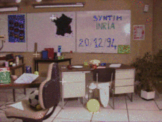
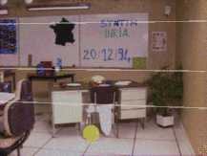
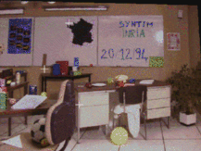
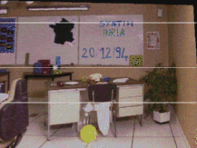
Rectification
Taken from: SYNTIM-INRIA.

Slide 76
Computing Correspondence

Slide 77
Correspondence
Similarity of patches
Geometric constraints:
Epipolar geometry
Global constraints:
Shape smoothness
Order preserving
..

Slide 78
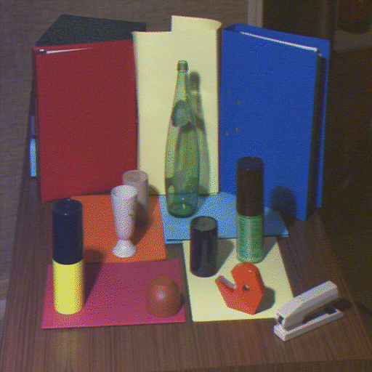
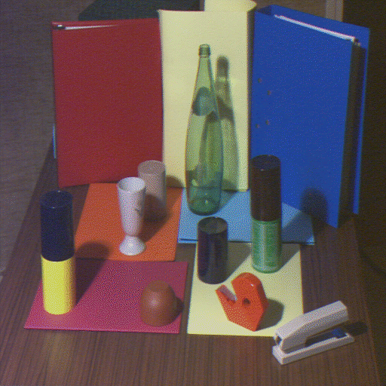
Points Attribute Constraints
A pair of corresponding points must have the same physical origin
Both are located on an edge due to a surface discontinuity, a shadow border, an occluding boundary, etc.

Slide 79
Occlusion
Occluded in
Right Image
Occluded in
Left Image
Right
Left
+
+
Center of
projection
Center of
projection

Slide 80
Uniqueness Constraint
Each pixel can correspond to at most one pixel in the other image
No transparency
No two or more points
project to the same point

Slide 81
Ordering Constraints
Corresponding points of similar depth typically maintain their order on the epipolar lines
This assumption does not hold when there is a depth discontinuity
p
q

Slide 82
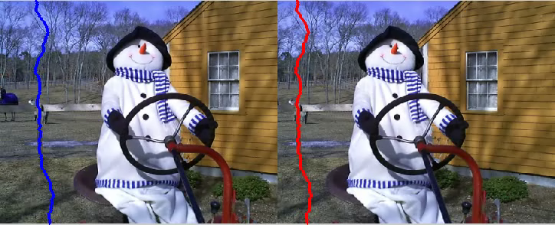
Stereo SC

Slide 83


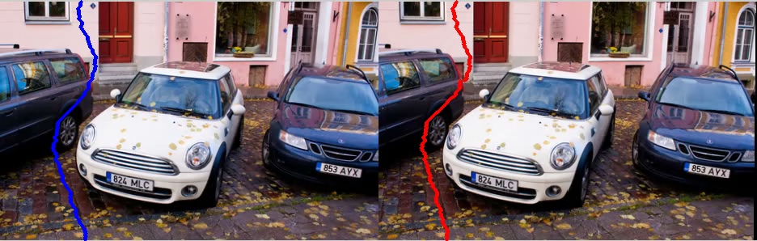
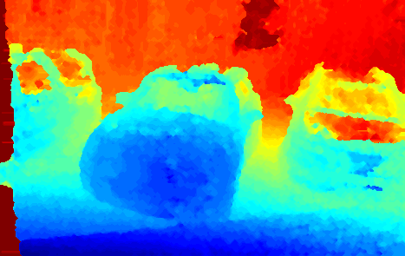

Slide 84
Disparity Smoothness Constraint
The disparity changes slowly almost everywhere in the image
True since the depth changes slowly almost everywhere in the 3D scene

Slide 85
Mutual Correspondence Constraint
The existence of a correspondence between points does not depend on whether we start from the left image or the right image

Slide 86
Computing Correspondence
Constraints:
Geometry, epipolar constraint
Photometric: Brightness constancy, only partly true
Ordering: only partly true
Smoothness of objects: only partly true
Features:
points, edges, regions, feature descriptors..

Slide 87
Correspondence Optimization
Local greedy matches:
Low-level: Bottom up methods are based on local attributes of points
1D search
2D search:
High-level: Minimizing an energy function that represents global and local properties of the surface (e.g., smoothness)

Slide 88
High Level Energy Function
Assume rectified images:
weight
Data Term
Regularization

Slide 89
1D: Dynamic Programing
Right
occlusion
p
Left occlusion
correspondence
t
s
q

Slide 90
More Issues
Calibration
Reconstruction under uncalibrated stereo
Structure from motion (three or more images)

Slide 91
Camera Calibration

Slide 92
Camera Calibration
Find the camera matrices:
Intrinsic parameters
Extrinsic parameters

Slide 93
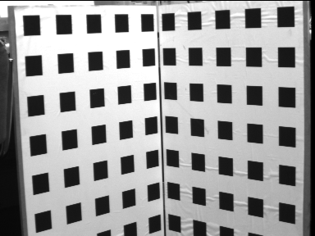
General Idea
Assumption:
Known 3D pattern
Known correspondence between image and object points
Solution:
Solve the linear equations: where p_{i} and P_{i} are known and M is unknown

Slide 94
The General Case
Equality of 2D points in the projective space: v×u=0
→ knowing p_{i} and P_{i} defines a set of linear equations in M

Slide 95
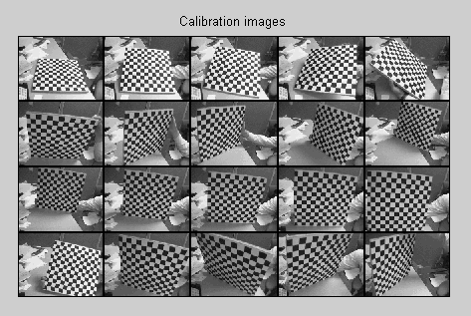
Calibration based on a planar surface
Using several images allow to compute M and their location with respect to each other

Slide 96
Uncalibrated Stereo
Calibration is necessary to determine absolute 3D positions
We can determine relative 3D positions (up to a scale factor) without calibration

Slide 97
What if we do not know the external parameters?
P
The disparity:
d =x_{l}-x_{r}
Z
O_{L}
O_{r}
x_{l}
x_{r}
f_{l}
p_{l}
p_{r}
f_{r}=f_{l}
T
cop_{l}
cop_{r}

Slide 98
A Priory Knowledge
Intrinsic and extrinsic parameters
Intrinsic parameters
No information about parameters
3D-Reconstruction From 2 Views
Unambiguous
Up to unknown scaling factor
Up to unknown projective transformation

Slide 99
Stereo Summary
Triangulation
Correspondence
Epipolar geometry+ heuristics
Calibration
Remember: 3D reconstruction is possible only from 2 independent images

Slide 100
Other Pairs of Images

Slide 101
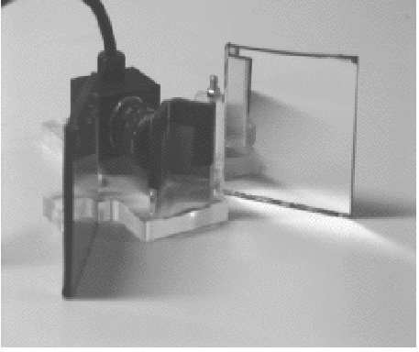
Mirrors
Taken from Mathieu and Devernay INRIA

Slide 102
Structured Light
known camera and projector geometry
Depth can be recovered by triangulation

Slide 103
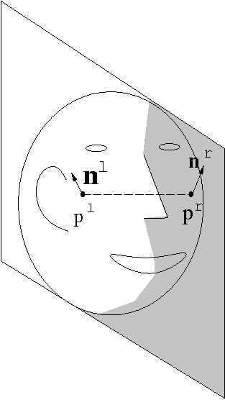

Bilateral Symmetry

Slide 104
Special Cases
A planar scene:
Perspective
Orthographic

Slide 105
Homography

Slide 106
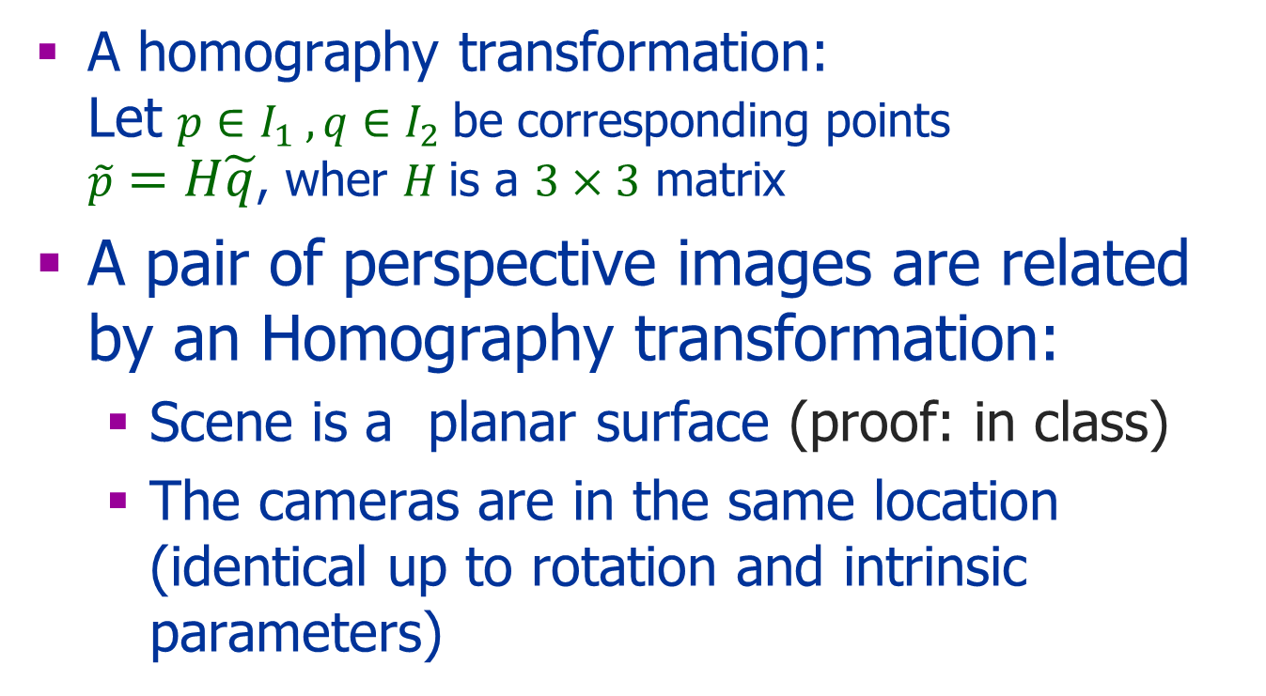
Homography
A homography transformation: Let $p∈I_{1} ,q∈I_{2}$be corresponding points $\tilde{p}=H\tilde{q}$, wher $H$is a $3×3$ matrix
A pair of perspective images are related by an Homography transformation:
Scene is a planar surface (proof: in class)
The cameras are in the same location (identical up to rotation and intrinsic parameters)

Slide 107
Homography
Computing the Homography
Using the projection matrices (known plan)
Using 4 corresponding points
Using optical flow (later in the course)
Applications:
Mosaics: stitching images together
3D structure

Slide 108
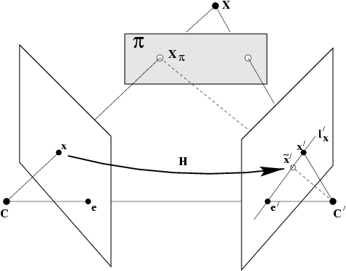
Plane-Induced Parallax: 3D Reconstruction
Decompose motion of scene points into two parts:
2D homography (as if all points coplanar)
Plane-induced parallax
Parallax: distance d relative to homography
d is proportional to
3D distance from plane
from Hartley & Zisserman

Slide 109
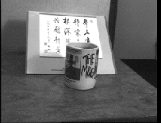
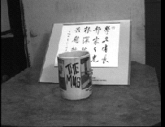
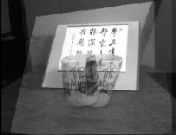
Plane-Induced Parallax
Left view superimposed on right using homo-graphy induced by plane of paper
Left view
Right view
from Hartley & Zisserman

Slide 110
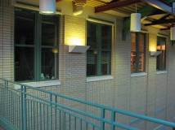
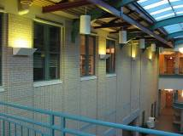
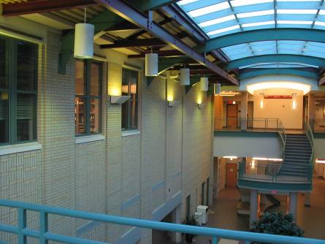


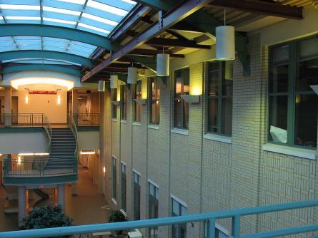

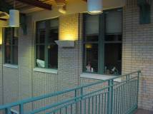
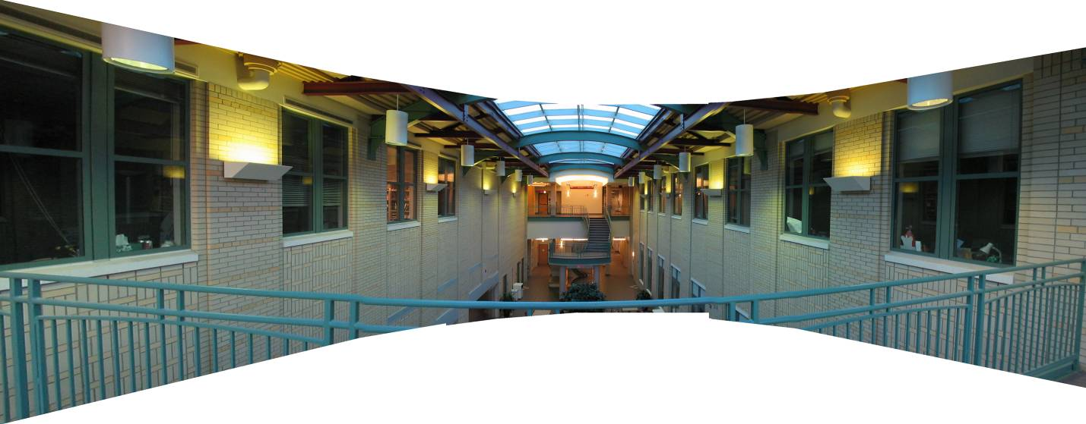
Homography: Pure Rotation
Taken from Jeffrey Martin
110
virtual wide-angle camera

Slide 111
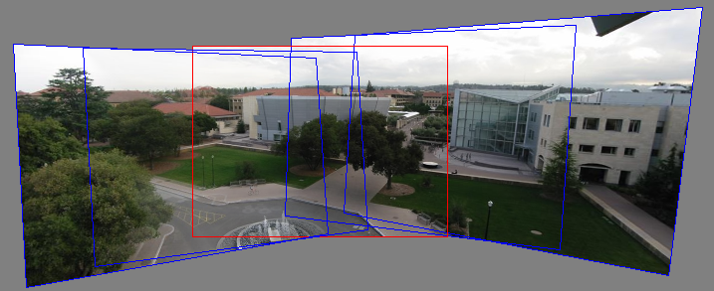
Panoramas
Pick one image (red)
Warp the other images towards it (usually, one by one)
blend
Taken from Jeffrey Martin

